Slide 1

CanSat: Cyclone
Ashwin Ahuja, Benjamin Yass, Quentin Gueroult, William Eustace, James Crompton, Nicholas Palmer, Daniel Halstead, Philip Fernandes, Monty Evans
http://teamcycl.one

Slide 2
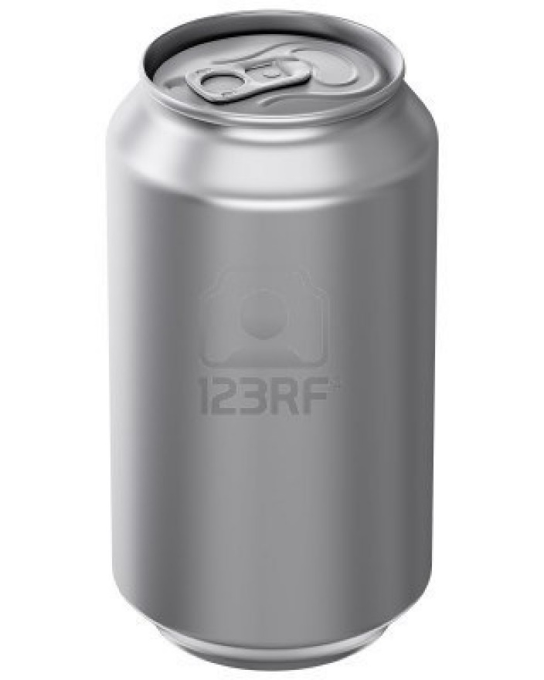
CanSat
Design and build an experiment
115mm high 66mm diameter
To be fired up 1km
Collect and transmit data on the way down
Any secondary mission
Notes:
What the project is

Slide 3
Previous SPS Teams
Team Eclipse- 2010 European Winners
Team Aspire- 2012
Team Vortex- 2013 European 3rd Place
Team Nova- 2014
Team Impulse- 2015 European Winners
Notes:
Waffle about how well we’ve done and previous failed quadcopter

Slide 4
Our idea
Primary Mission: To measure and transmit air pressure and temperature data
Secondary Mission: “To produce a quadcopter capable of surveying an extra-terrestrial planet, using a live-feed camera, finding the topography and investigating the possibilities of flora and fauna. The drone should be capable of investigating the air through which it is passing: finding the dew point of the air, useful for finding the quality (combining with the temperature) of the area for agriculture, thus human inhabitability. Finally, the drone should be able to navigate autonomously, in order that it can investigate specific sites. “
Notes:
To do the requirement and be able to control it flying

Slide 5
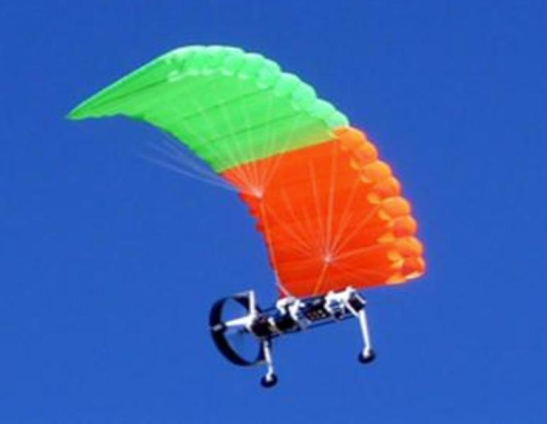
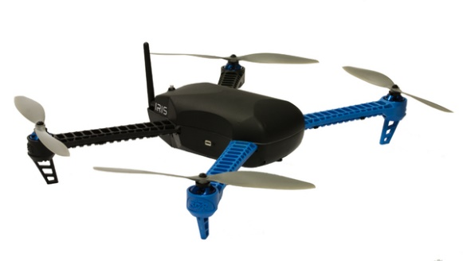
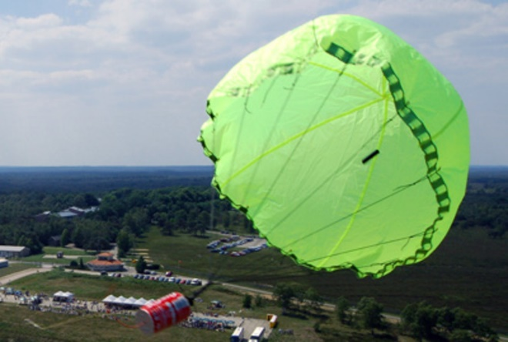
Concepts
Parafoil
Quadcopter
Parachute
Notes:
Parafoil, Quadcoptor, other in that order

Slide 6
Key Problems
Stability -Can if fly
Power - If so for how long?
How do we control it?
Will everything fit inside?
Can we not have a parachute?

Slide 7
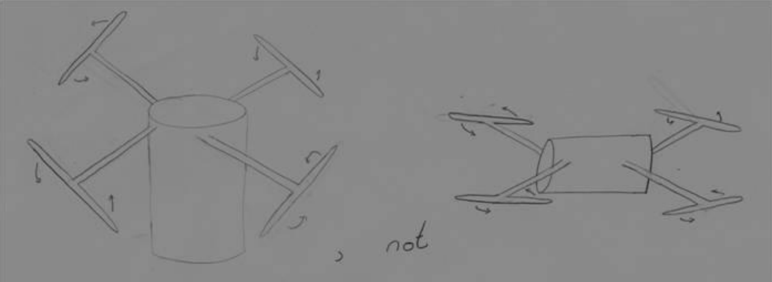
Orientation
Orientation
For stable flight you must maximise distance between propellers
Notes:
Orientation

Slide 8
Design
Notes:
Option of holdy thingys and plate to rest on, also fillet for strength, going into discussion of how lines act as focus points for stress

Slide 9
Design

Slide 10
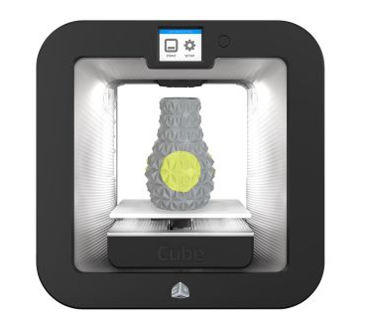
How we are making it
3D Printing on the Cube
Bolting pieces together

Slide 11
Redesign

Slide 12
Unfolding the arms
Notes:
MAKE SURE YOU NOTE THAT THIS WAS UNNECESSARY

Slide 13
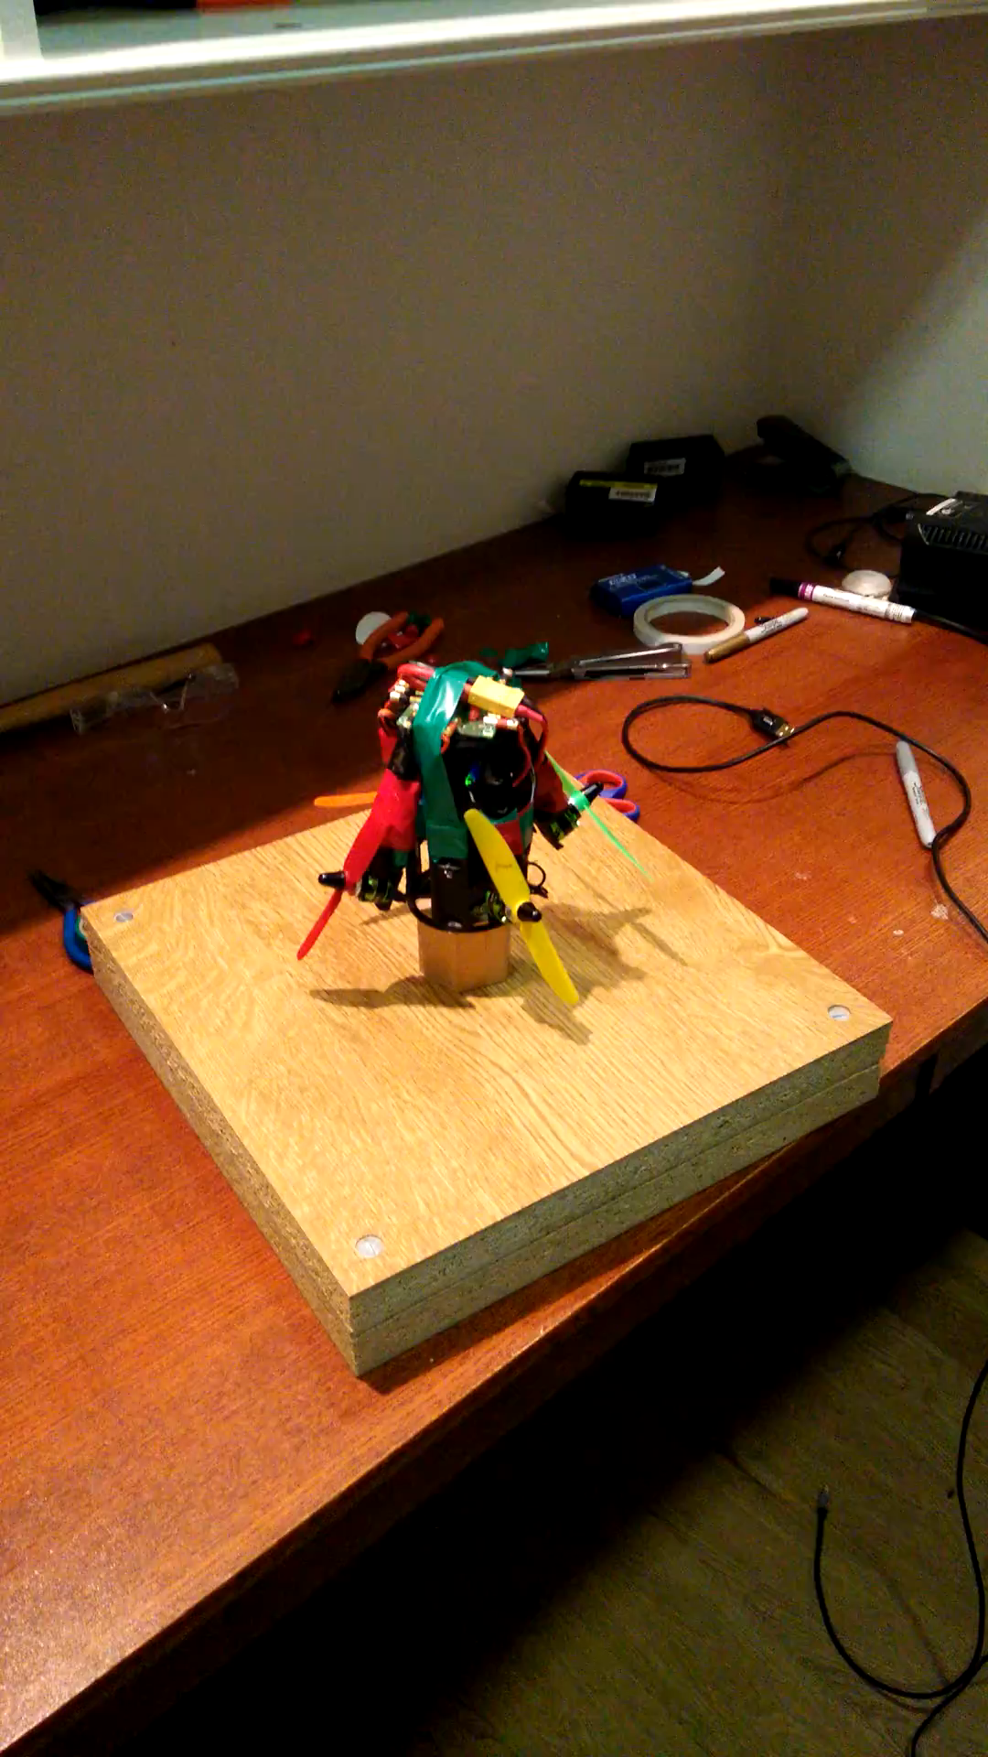

Slide 14
Electronics and Software

Slide 15
Deciding on Parts
Sensor System
Camera System
Flight System

Slide 16
Sensor System
Temperature and Pressure – MS5637
RF Transceiver System – Hope RFM98W
Temperature and Humidity – HYT271
GPS – GP-2106
9DOF IMU – Sparkfun 9DOF IMU
SD Card – Sparkfun OpenLog
Notes:
Meeting our specification
Avoiding the tempting to put all the sensors we could find
To meet primary mission, we immediately need a temperature and pressure system, a MS5637, meets all of these specifications – 0.01C accuracy and 0.1mbar and also need an RF transceiver setup.
Hope RFM98W – Low Power, Long Range (has been used to around 180km!!) –
Communication spread over different frequency channels and data-rates – SPREAD SPECTRUM TECHNOLOGY
Data range rates can range from 0.3kbps to 50kbps

Slide 17
Camera System
1st Plan was making use of 2.4GHz (WiFi transmission) using an Intel Edison and a mini HD camera
Final plan was making use of 5.8GHz FPV Transmission
Mini HD Camera
25mW FPV Transmitter
Notes:
– problem with a lack of range + size requirements
25mW legal limit… however, still better quality

Slide 18
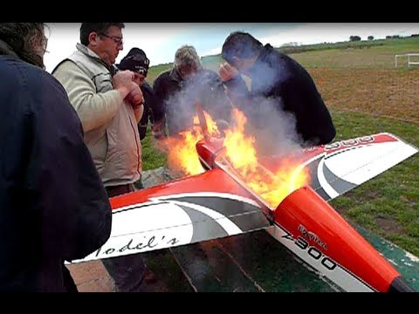
Flight System
Control Board – OpenPilot CC3D
Turnigy Outrunner V2 Motors
DYS 15A ESCs
2.4GHz TX / RX Transceiver System
850mAh Battery – 11.1V (3S)
Notes:
Do we make our own system or buy them – generally buy them… because though we could make them they would be more expensive (cost for lack of volume) – HOBBYKING SPONSORSHIP
Control Board was chosen because it was very easy to reprogram – and generally allows us to account for any issues that occur mid glight
Motors were powerful enough and small enough
ESCs were chosen based on the motors
2.4GHz TX / RX was very small
850mAh was based on achieving at least 5 minutes of flight – our minimum aim – though early testing has shown that we will achieve far more than that 5 minutes – probably closer to 10 minutes
BUT LiPos – maybe it will burn – very high energy density

Slide 19
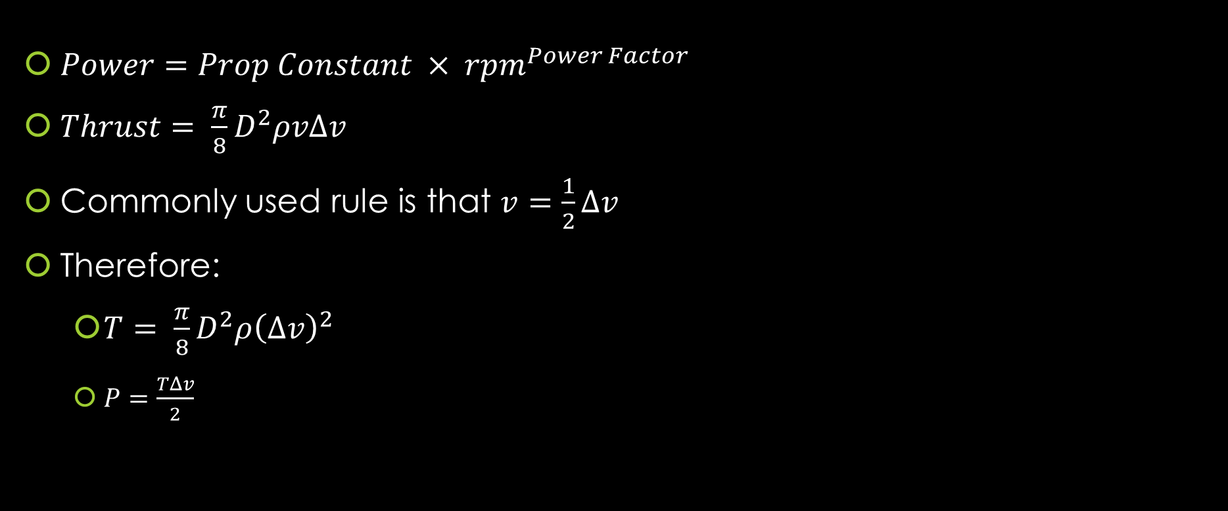
Calculating thrust
$Power=Prop Constant × {rpm}^{Power Factor}$
$Thrust= \frac{π}{8}D^{2}ρvΔv$
Commonly used rule is that $v=\frac{1}{2}Δv$
Therefore:
$T= \frac{π}{8}D^{2}ρ{\left(Δv\right)}^{2}$
$P=\frac{TΔv}{2}$
Notes:
Power is in watts
Rpm in thousands
T = thrust (N)
D = Propeller Diamter (m)
V = velocity of air at the propeller (m/s)
Delta v = velocity of air accelerated by the propeller (m/s)
Ro = density of air
6x4 Propeller has propeller constant of 0.015 and power factor of 3.2
Calculating thrust of our motors = we have a thrust of over 400g per

Slide 20

$T={\left(\frac{π}{2}D^{2}ρP^{2}\right)}^{\frac{1}{3}}$
$m=\frac{{\left(\frac{π}{2}D^{2}ρP^{2}\right)}^{\frac{1}{3}}}{g}$ (by F = ma)

Slide 21
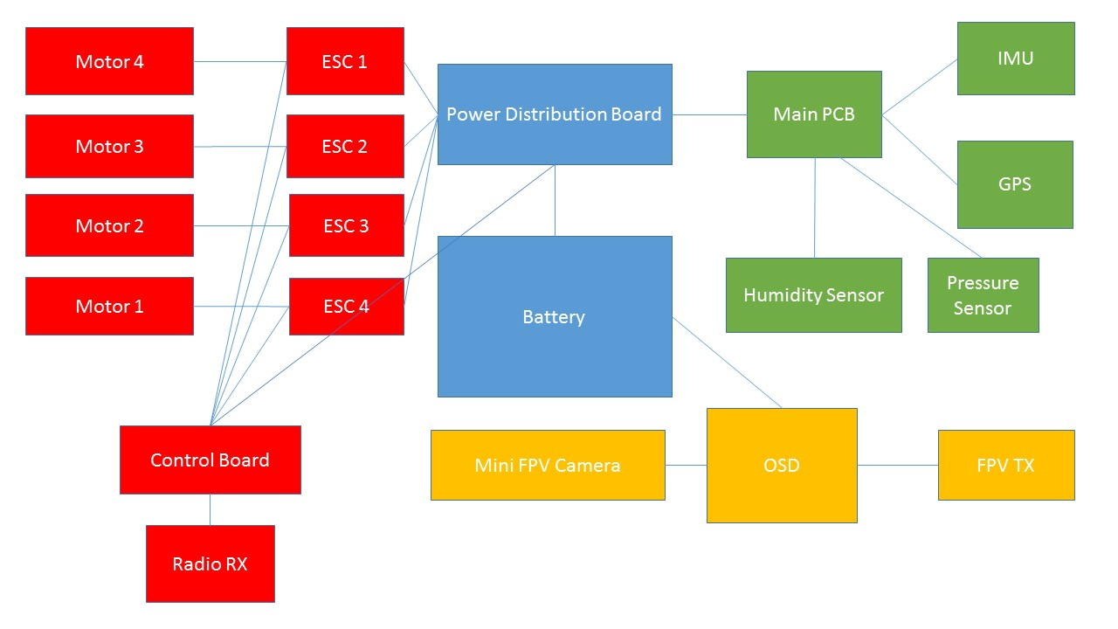

Slide 22
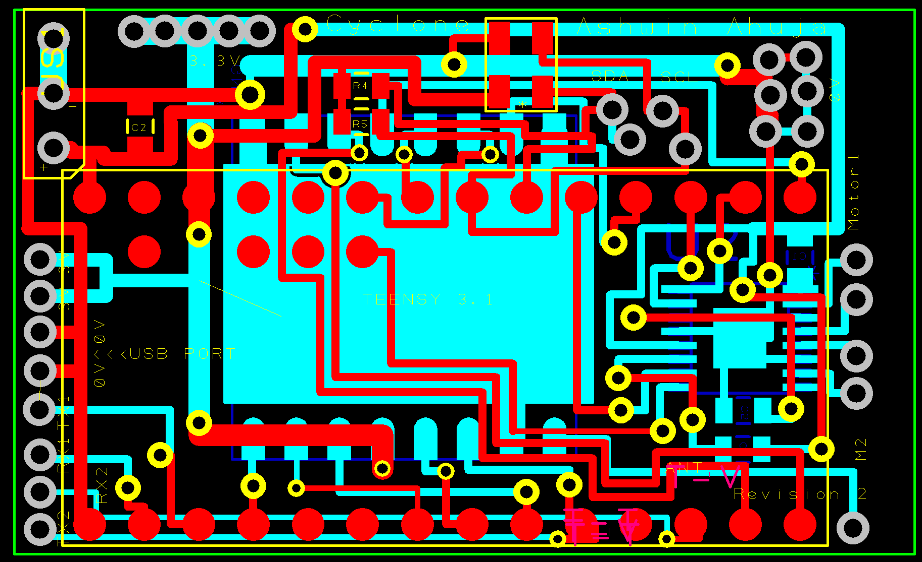
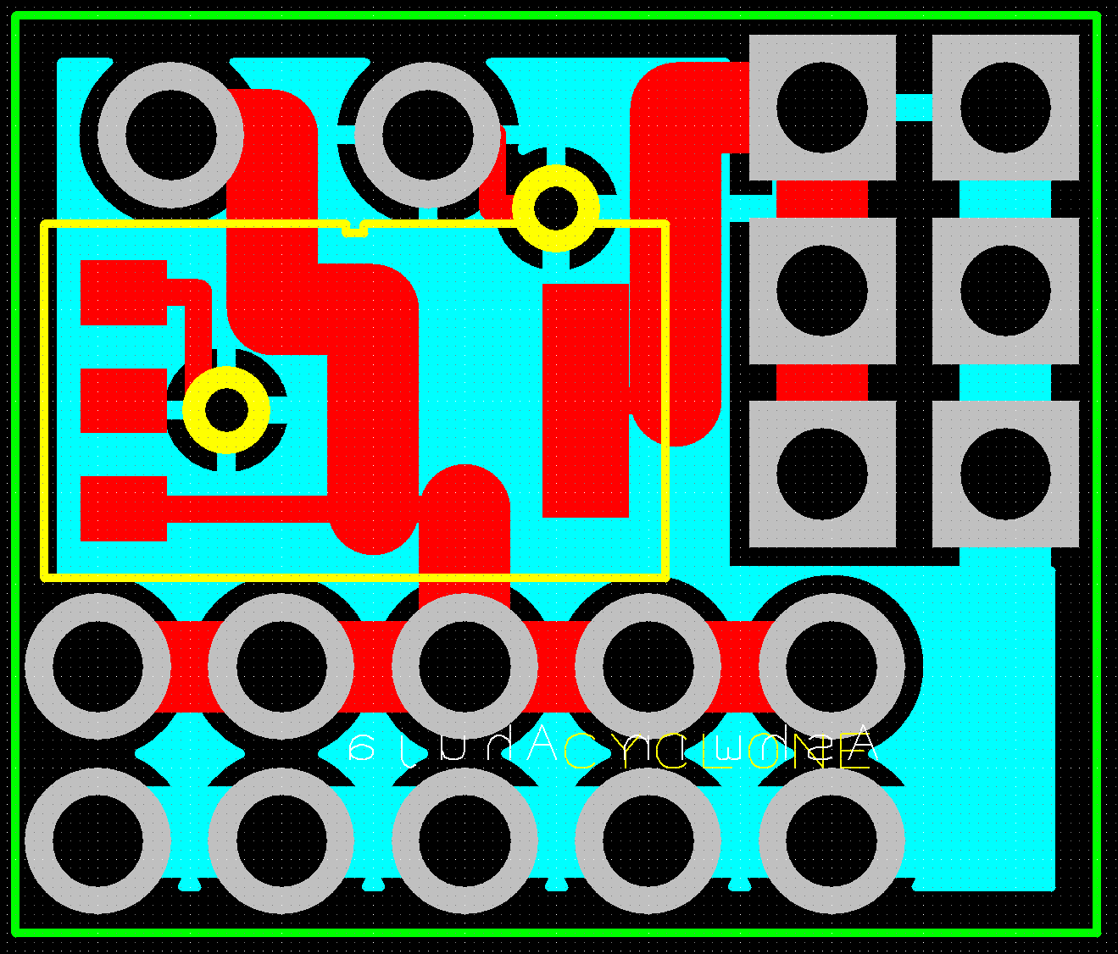

Slide 24
Software
Base Station Software – Windows Forms (C#) with a C++ backend for communications with the controller for autonomous motion.
Can Code – Arduino C
Data Processing – MATLAB
Notes:
How autonomous motion will work…?
Progress – Arduino is complete
BASE STATION SOFTWARE
Receives Serial Input from Hope RFM98W
Live Graphs Data – and creates a GUI
Allows the system to send an input to the can, in order to make changes to the data receiving of the can
Calculates altitude from Pressure measurements and finds agricultural potential from the data.
CAN CODE
Receives the data from all the sensors and sends it via RF Transmission to the Ground Station and saves it on the SD Card
DATA PROCESSING
Finds trends in the data – graphs it.

Slide 25
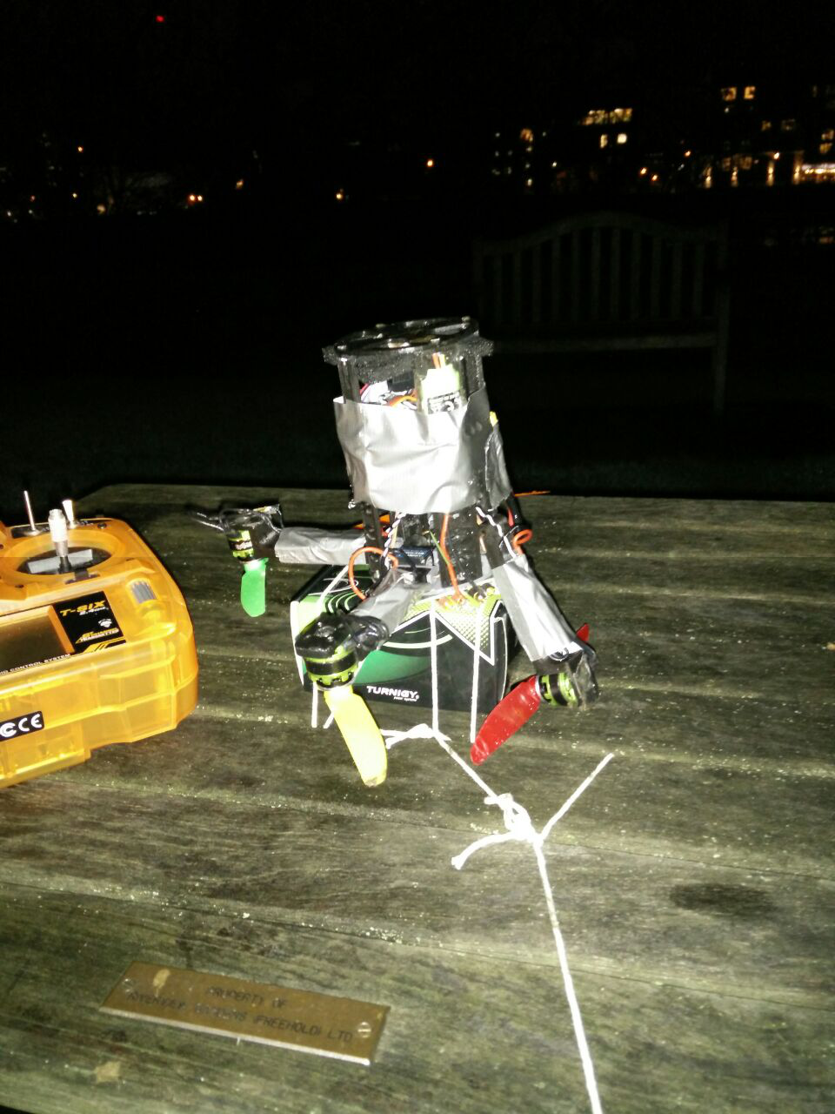
Coming together

Slide 26
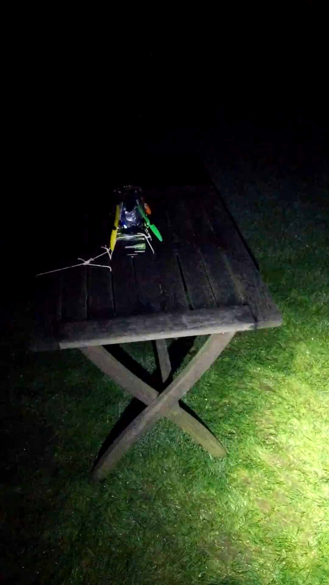

Slide 27
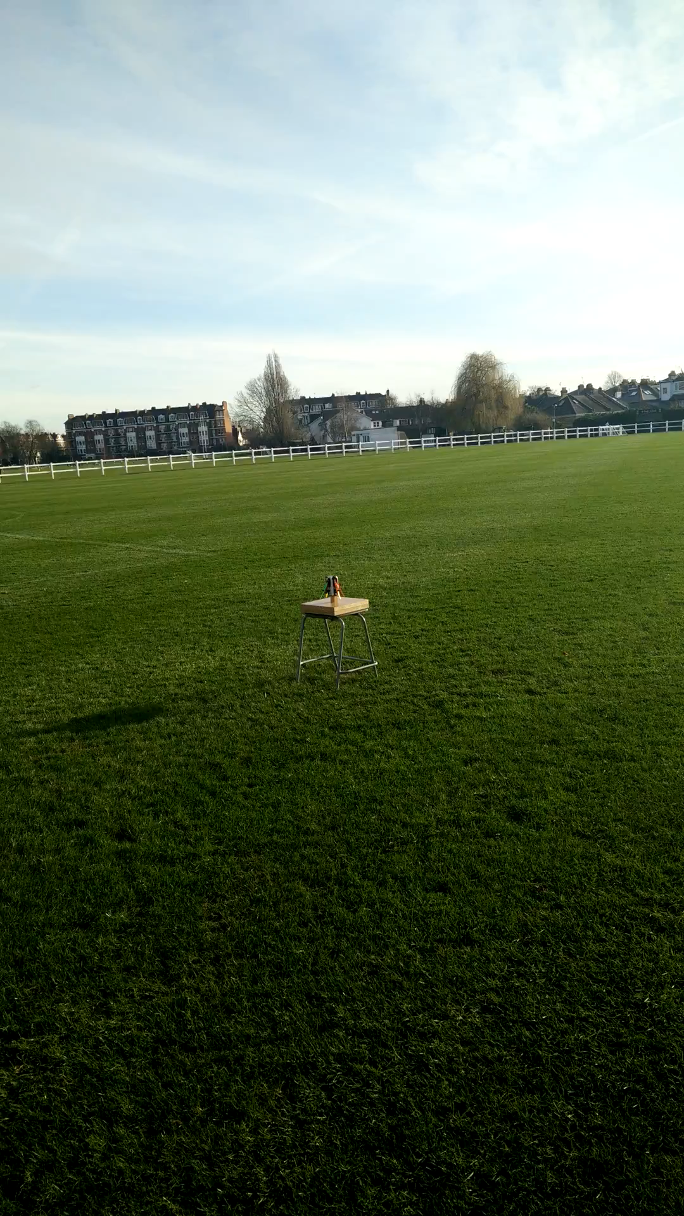

Slide 28
Where we are
Printing a new version as we speak
Going to York 10th - 12th March

Slide 29
Problems that we need to solve
Opening the arms
Durability of the final structure

Slide 30
Thanks for listening
Any questions?

